Slide 1


WELCOME TO THE 2ND ANNUAL
MISS BALLOU HIGH PAGEANT

Slide 2

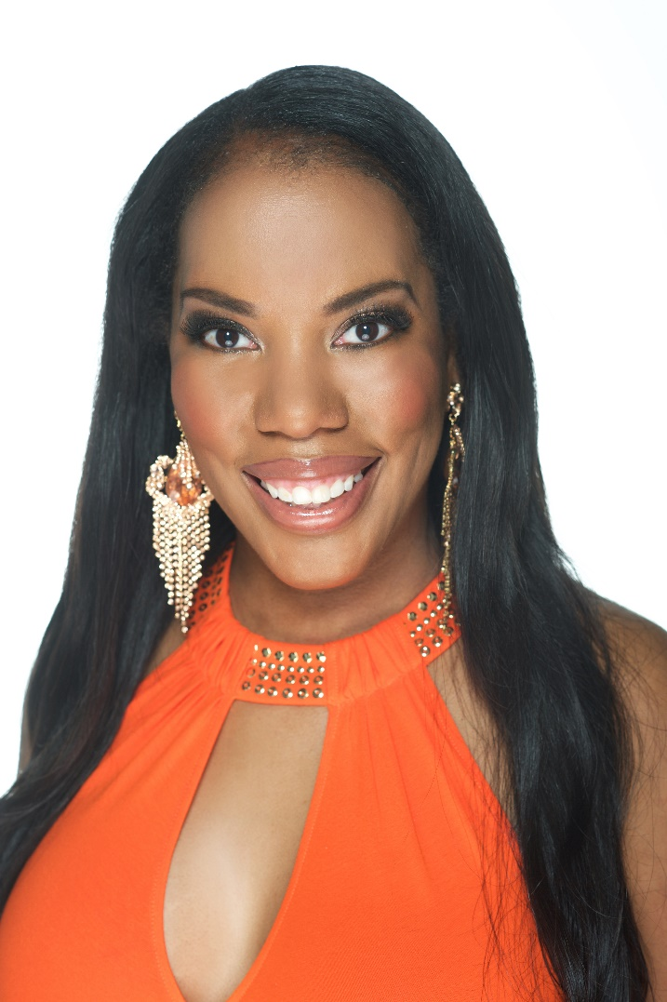
Ms. Monica L. Brokenborough ☺
Director/Choreographer

Slide 3
Miss Blue & Gold Contestants

Slide 4
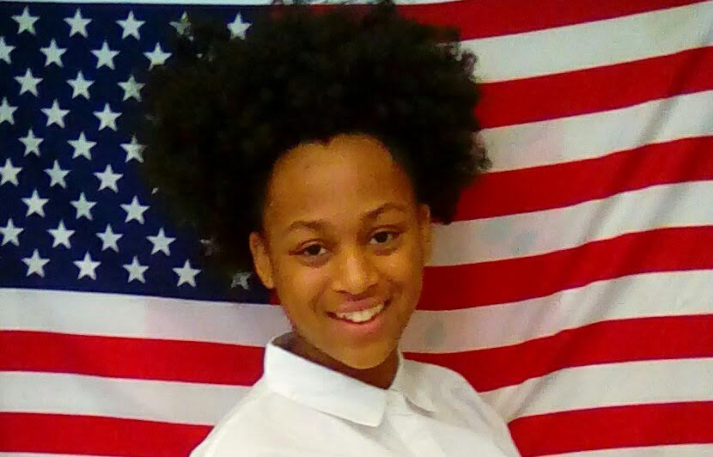
Tamia

Slide 5
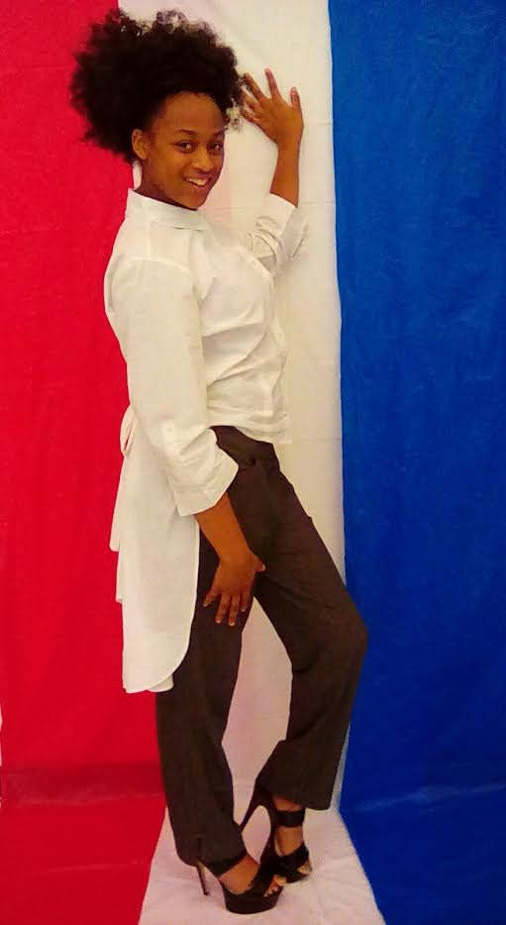
Tamia
Grade Level: Sophomore
G.P.A. – 3.0
Talent – Dance
Platform: Danger of Distracted Driving

Slide 6
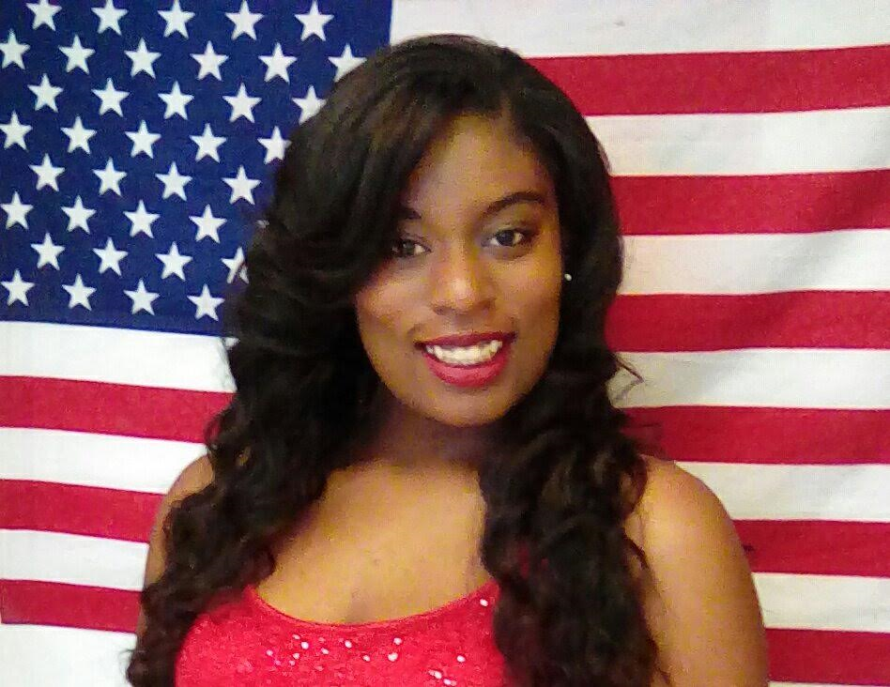
Shauntae

Slide 7
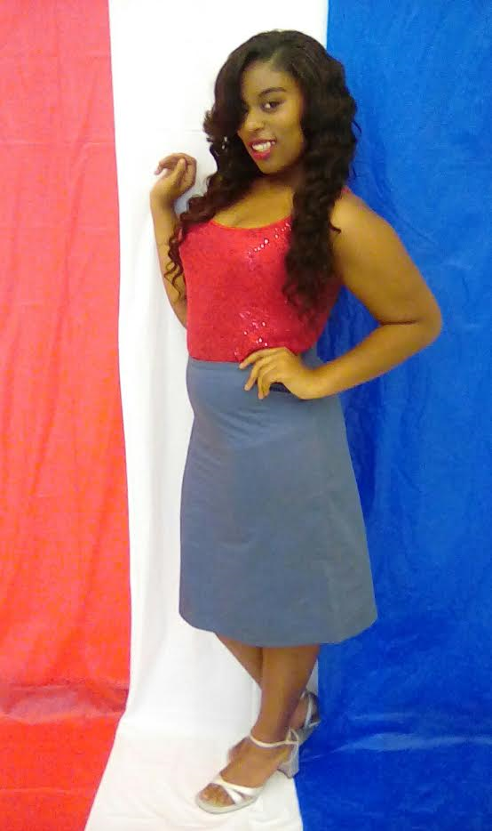
Shauntae
Grade Level: Freshman
Talent – Drama Mime Dance
Platform: Caring for Animals

Slide 8
Miss Junior Ballou High Contestant

Slide 9
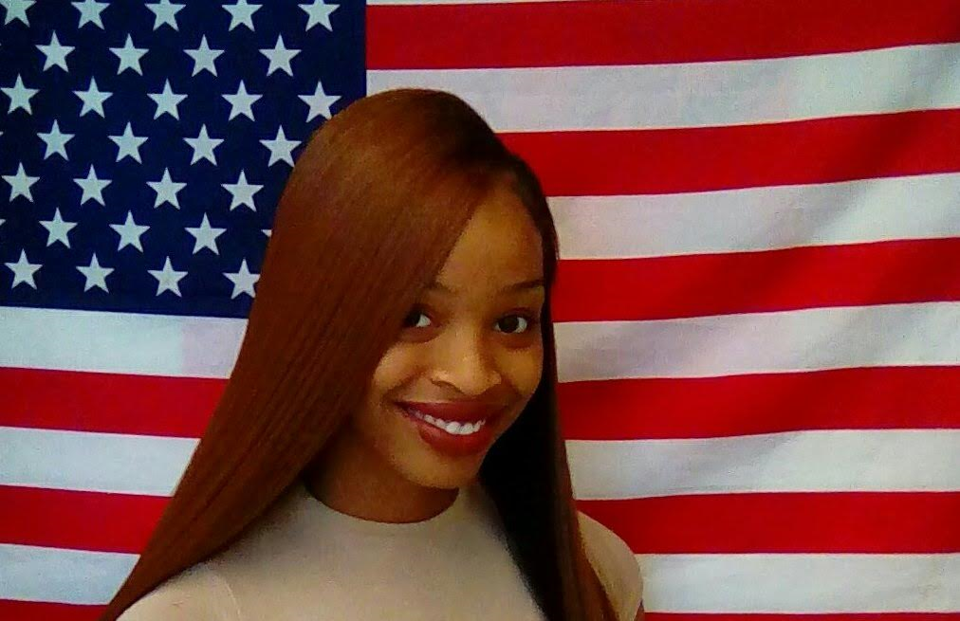
Ashanti

Slide 10
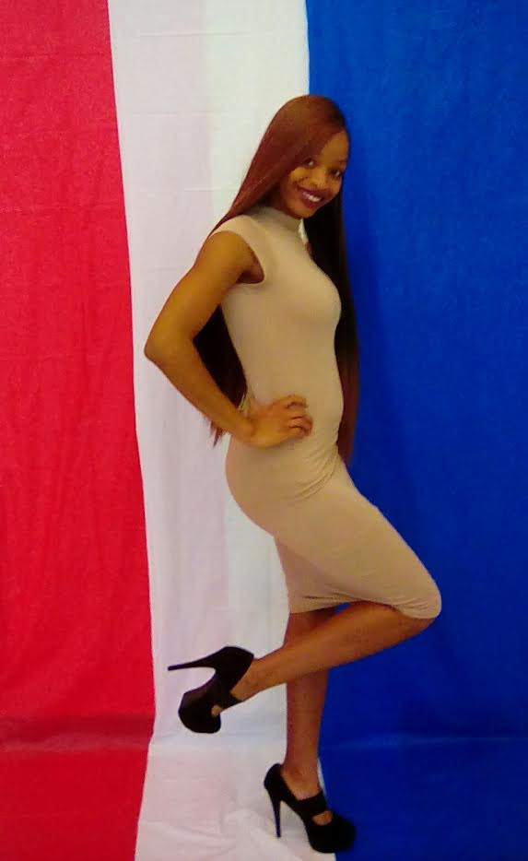
Ashanti
Grade Level: Junior
Talent – Contortionist
Platform: Helping the Homeless

Slide 11
Miss Ballou High Contestants

Slide 12
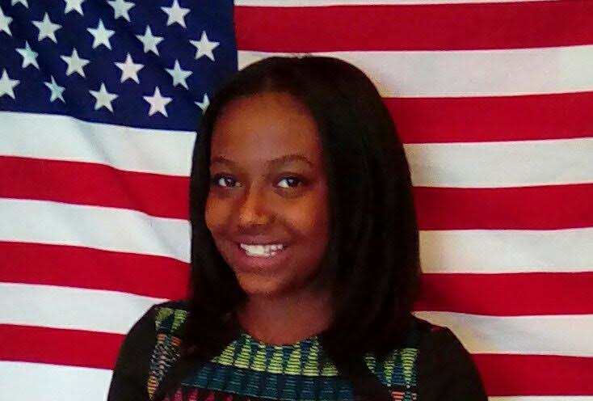
Carmela

Slide 13
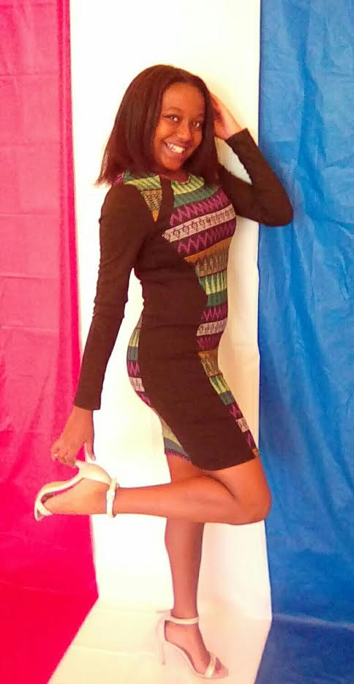
Carmela
Grade Level: Senior
G.P.A. – 3.3
Talent – African Dance
Platform: Bullying

Slide 14
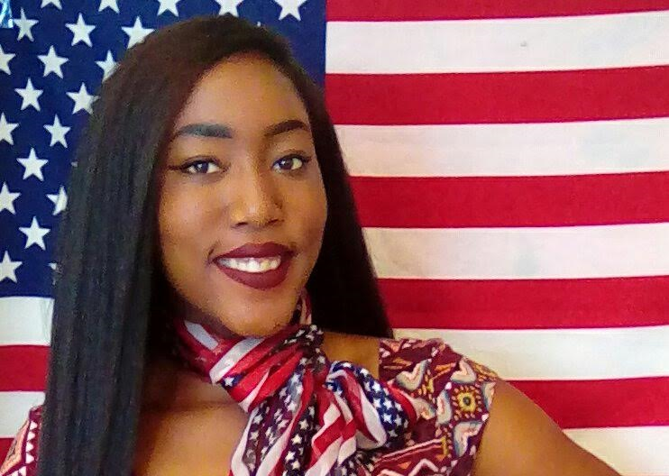
Diane

Slide 15
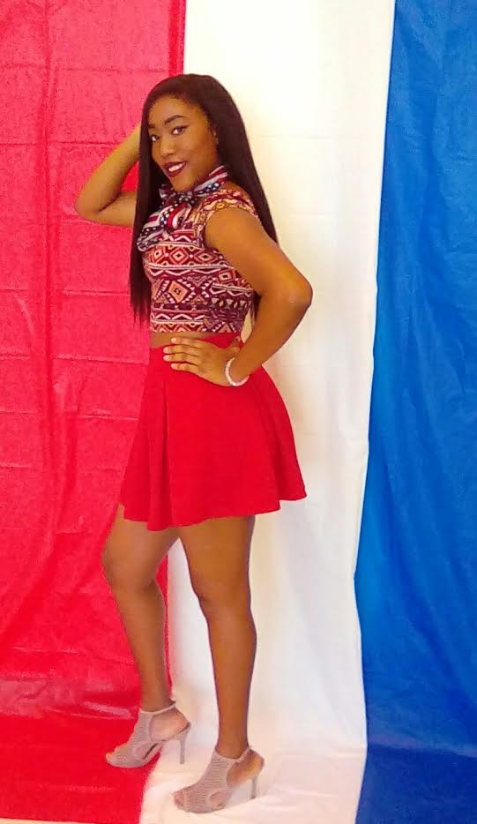
Diane
Grade: Senior
G.P.A. – 3.8
Talent – Vocal
Platform: The Issues of Education in Africa

Slide 16
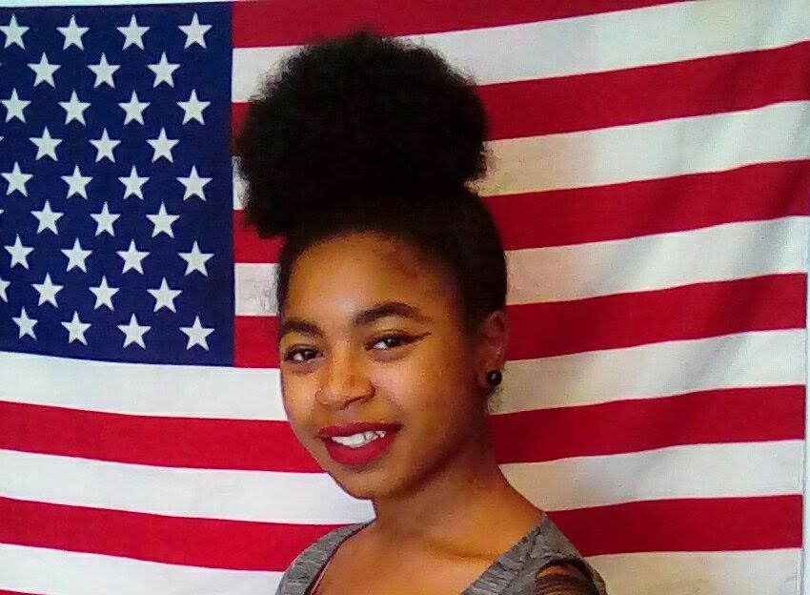
Iyonna

Slide 17
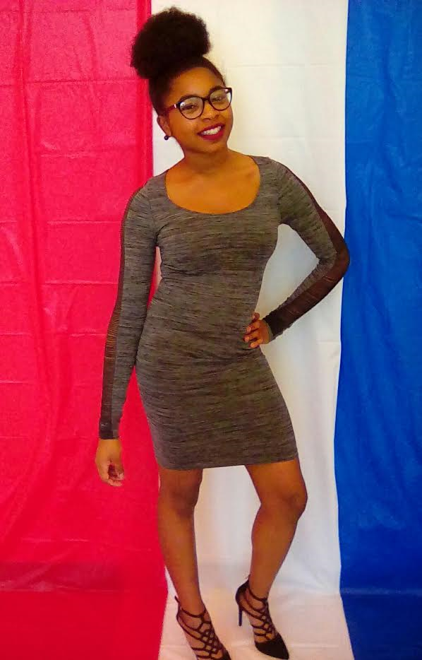
Iyonna
Grade Level: Senior
G.P.A. – 3.3
Talent – Clarinet
Platform: Care for Animals

Slide 18
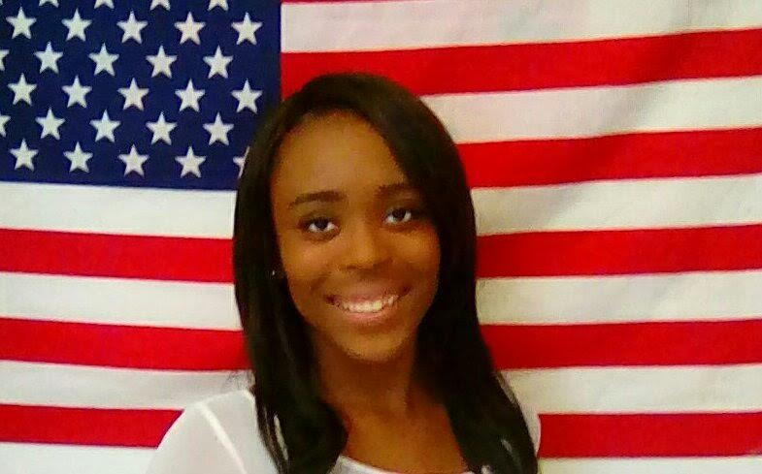
Kaiya

Slide 19
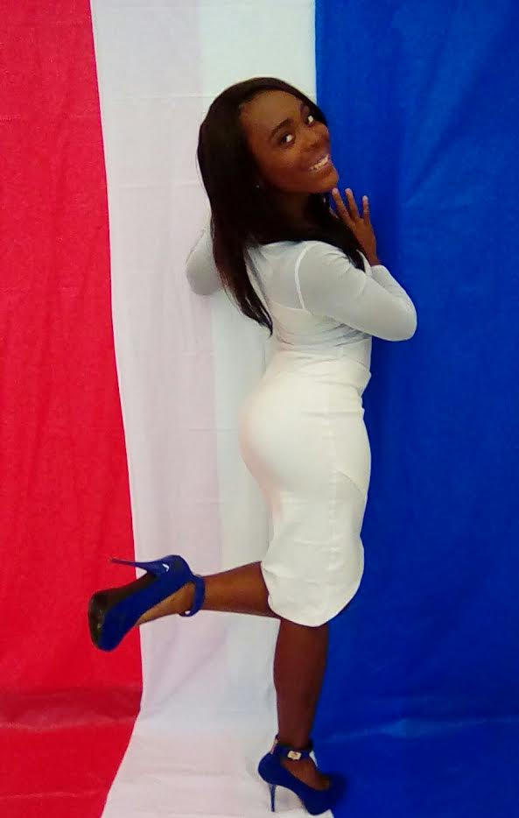
Kaiya
Grade Level: Senior
G.P.A. – 3.2
Talent – Dance
Platform: Early Childhood Education

Slide 20

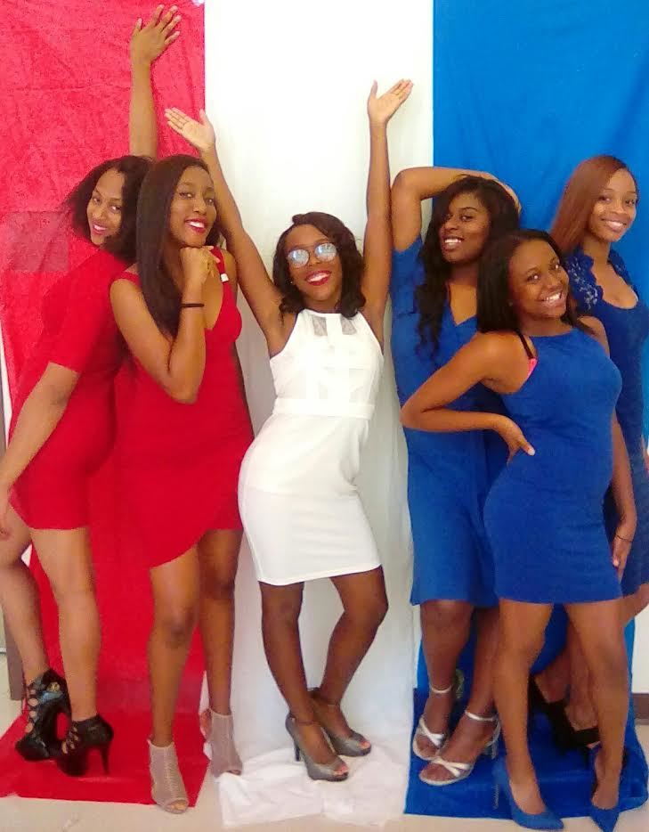
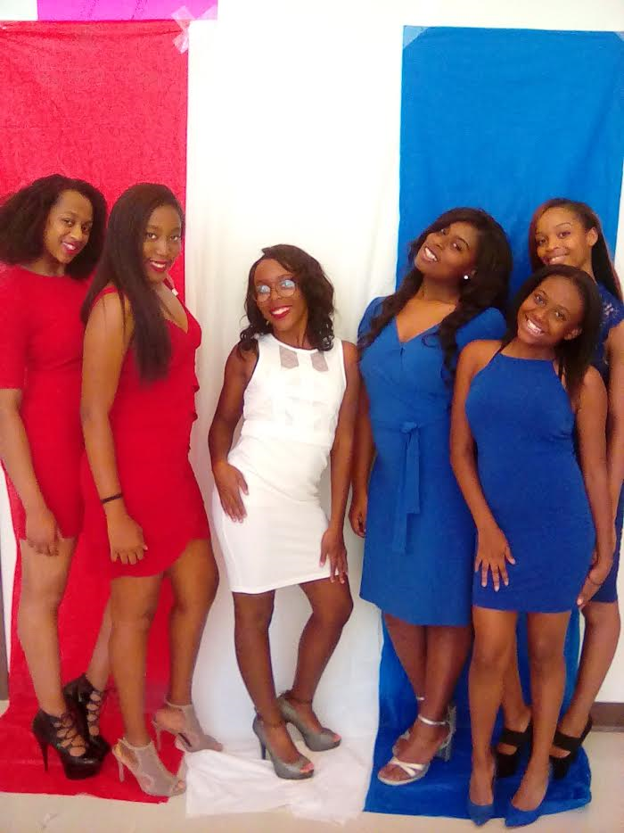
Best wishes to all of the contestants!

Slide 21

ENJOY THE PAGEANT ☺

